Slide 1
ESCAPE ROOM bolog sergiu-Robert Negrescu alexia sendy șofan laurențiu-mihai șucea alin-cristian

Slide 2
THE IDEA OF OUR PROJECT
This project is an interactive escape game built with an Arduino UNO board, incorporating multiple input sensors and a keypad. Players must solve a sequence of challenges to reveal a 4-digit code and input it via a keypad to "escape." Each digit of the code is generated based on unique interactions:
Button Press Challenge: Press a button a certain amount of times to generate the first random digit.
LED Blink Challenge: Press another button to light an LED a random number of times, revealing the second digit.
Ultrasonic Sensor Challenge: When an object is detected within 3 cm, the LCD displays the third digit.
Light Sensor Challenge: Exposing the photoresistor to bright light displays the fourth digit.
After collecting all four digits, players enter the code on a keypad. If the code is correct, the LCD displays “You escaped!”; otherwise, it shows “Try again”.

Slide 3
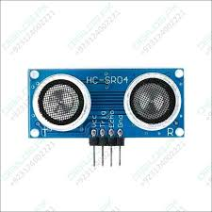
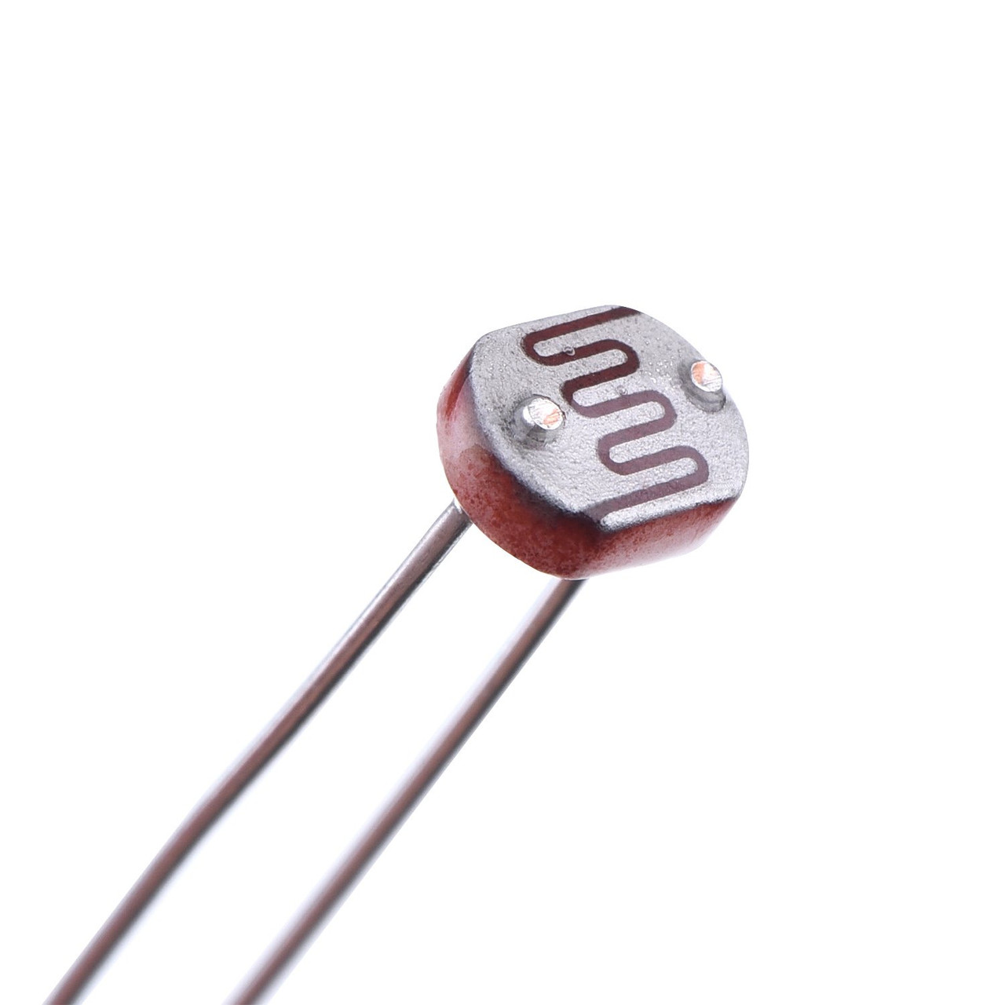
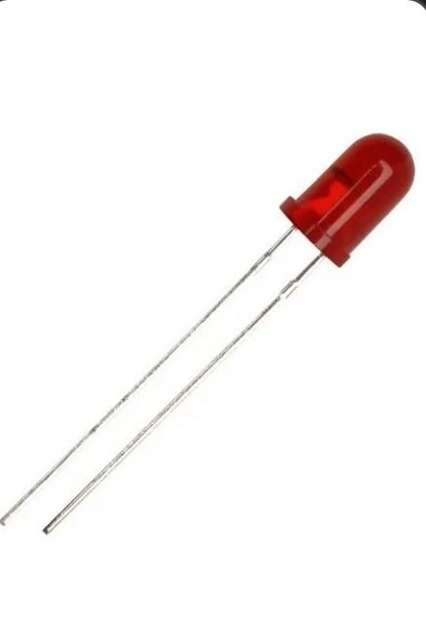
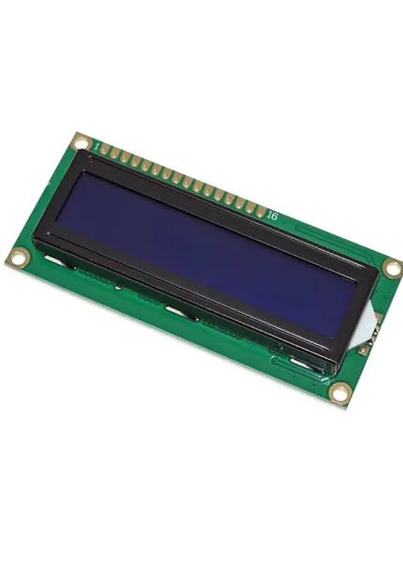
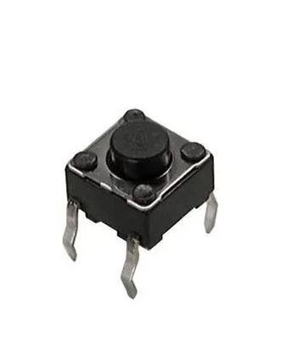
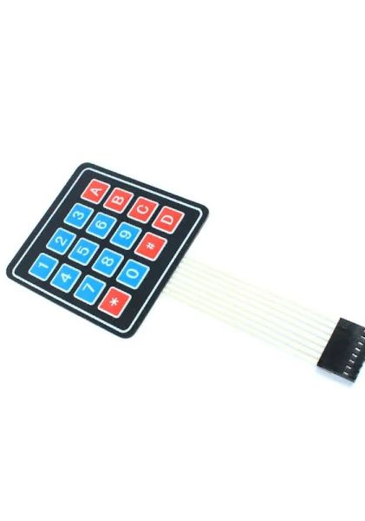
Sensors and actuators used
Ultrasonic sensor
Photoresistor
LED
Buttons
Keypad
LCD

Slide 4
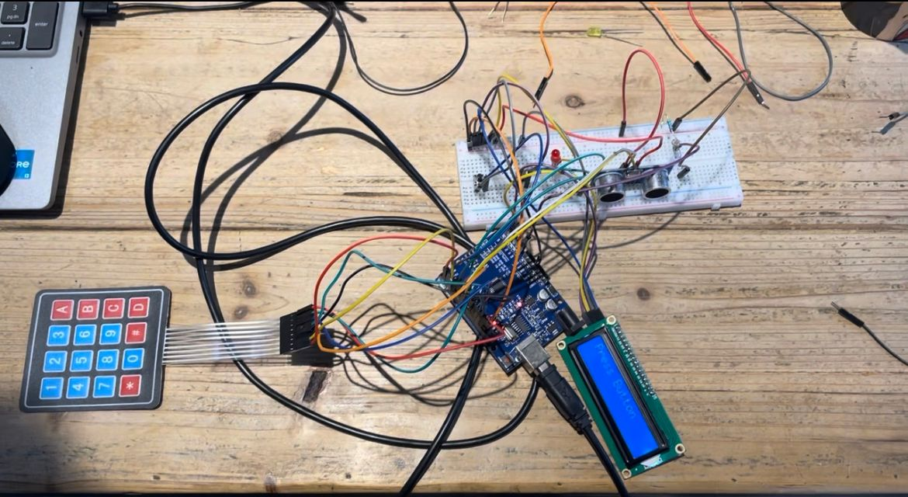
PHOTO OF OUR PROJECT

Slide 5
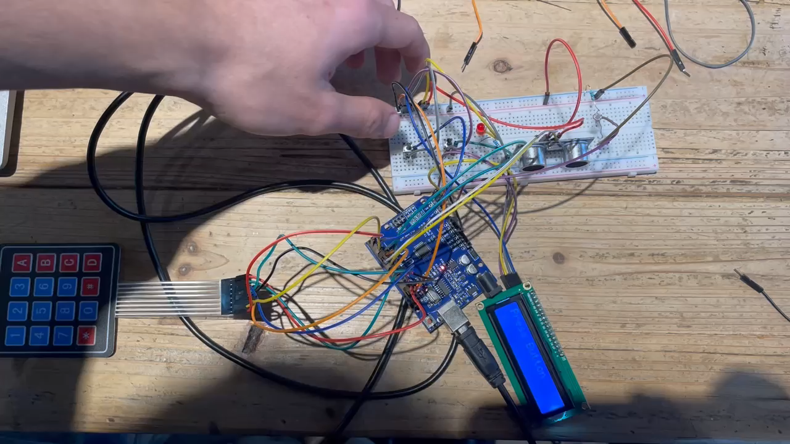
Short demo of our project

Slide 6
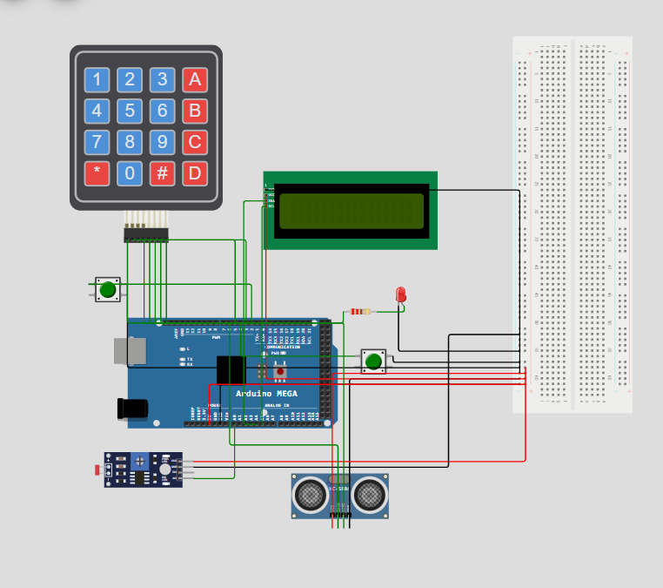
ELECTRICAL SCHEME

Slide 7
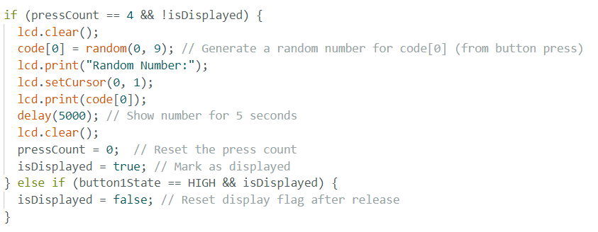
THE CODE FOR GENERATING THE FIRST DIGIT

Slide 8
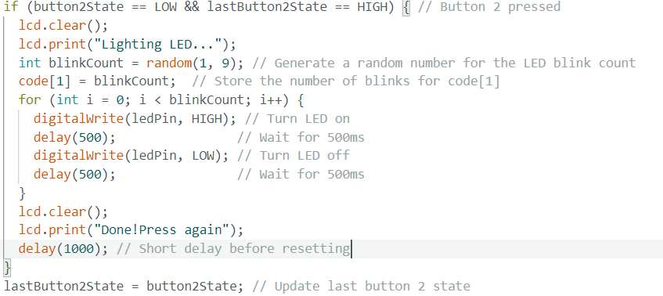
THE CODE FOR GENERATING THE SECOND DIGIT

Slide 9
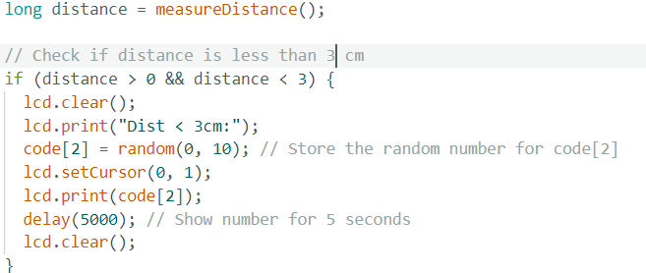
THE CODE FOR GENERATING THE THIRD DIGIT

Slide 10
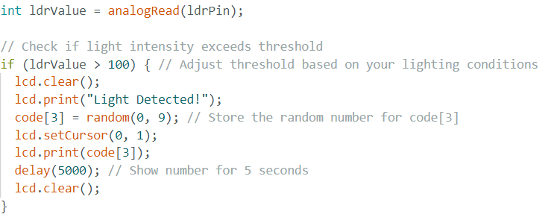
THE CODE FOR GENERATING THE FOURTH DIGIT

Slide 11
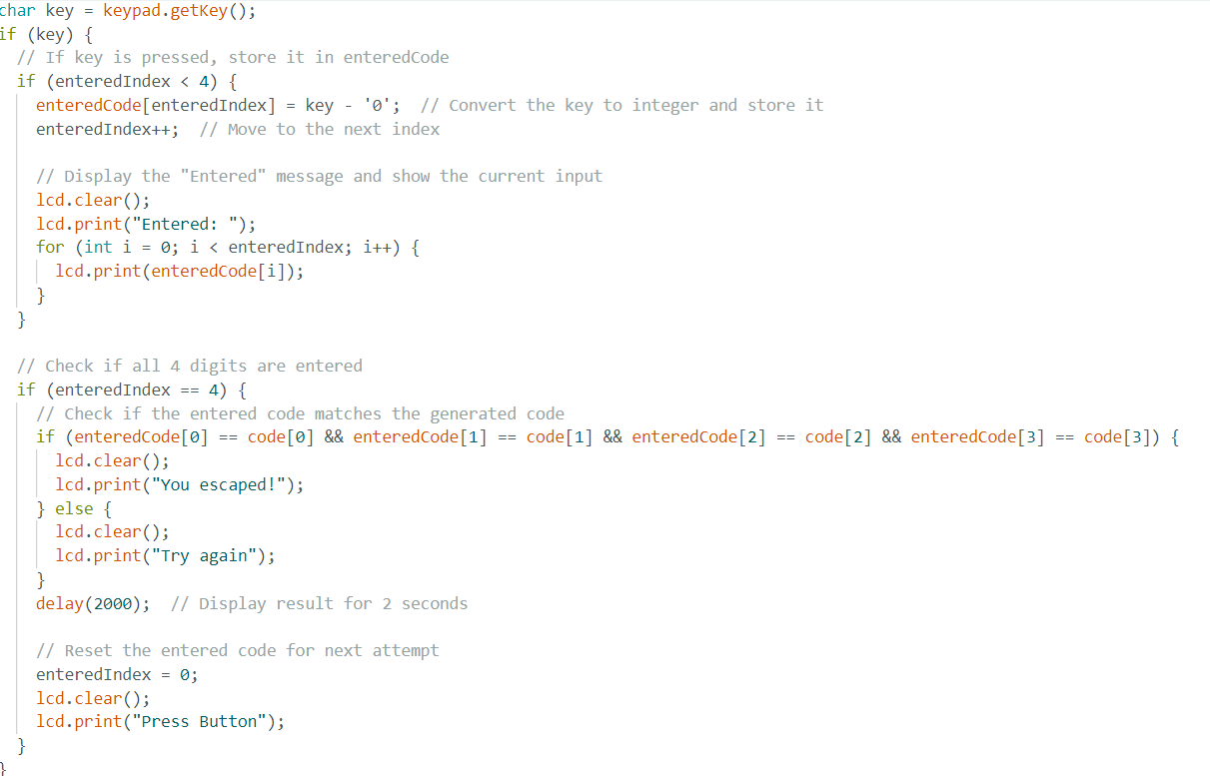
THE CODE FOR ENTERING THE CODE ON THE KEYPAD

